Slide 1
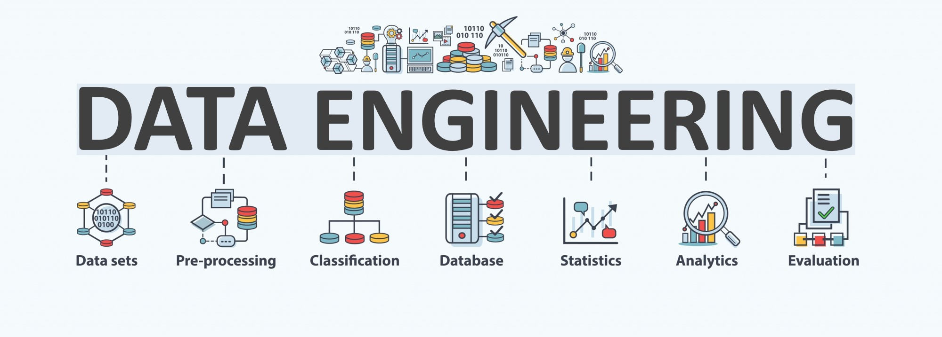

Lecture 7: Data Driven Applications (1) -- Information Retrieval and Recommendations
CS5481 Data Engineering
Instructor: Yifan Zhang

Slide 2
Outline
Information filtering
Information retrieval – process, approaches
Recommendations – process, approaches

Slide 3
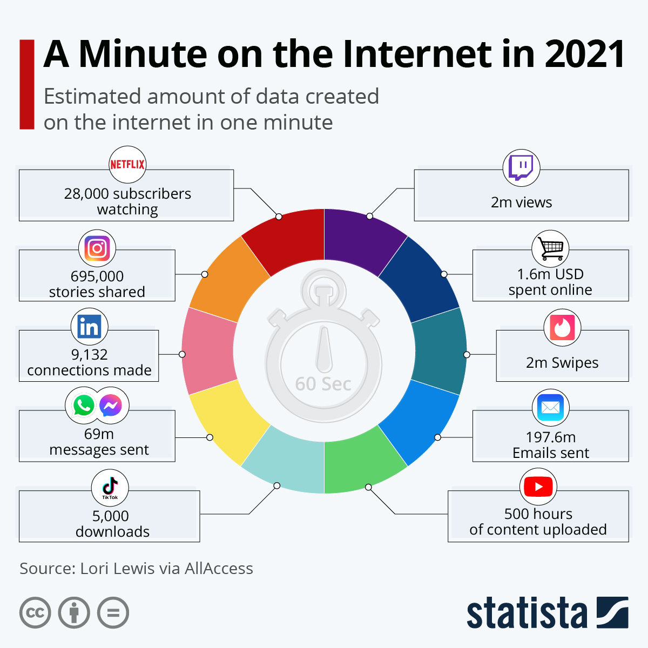
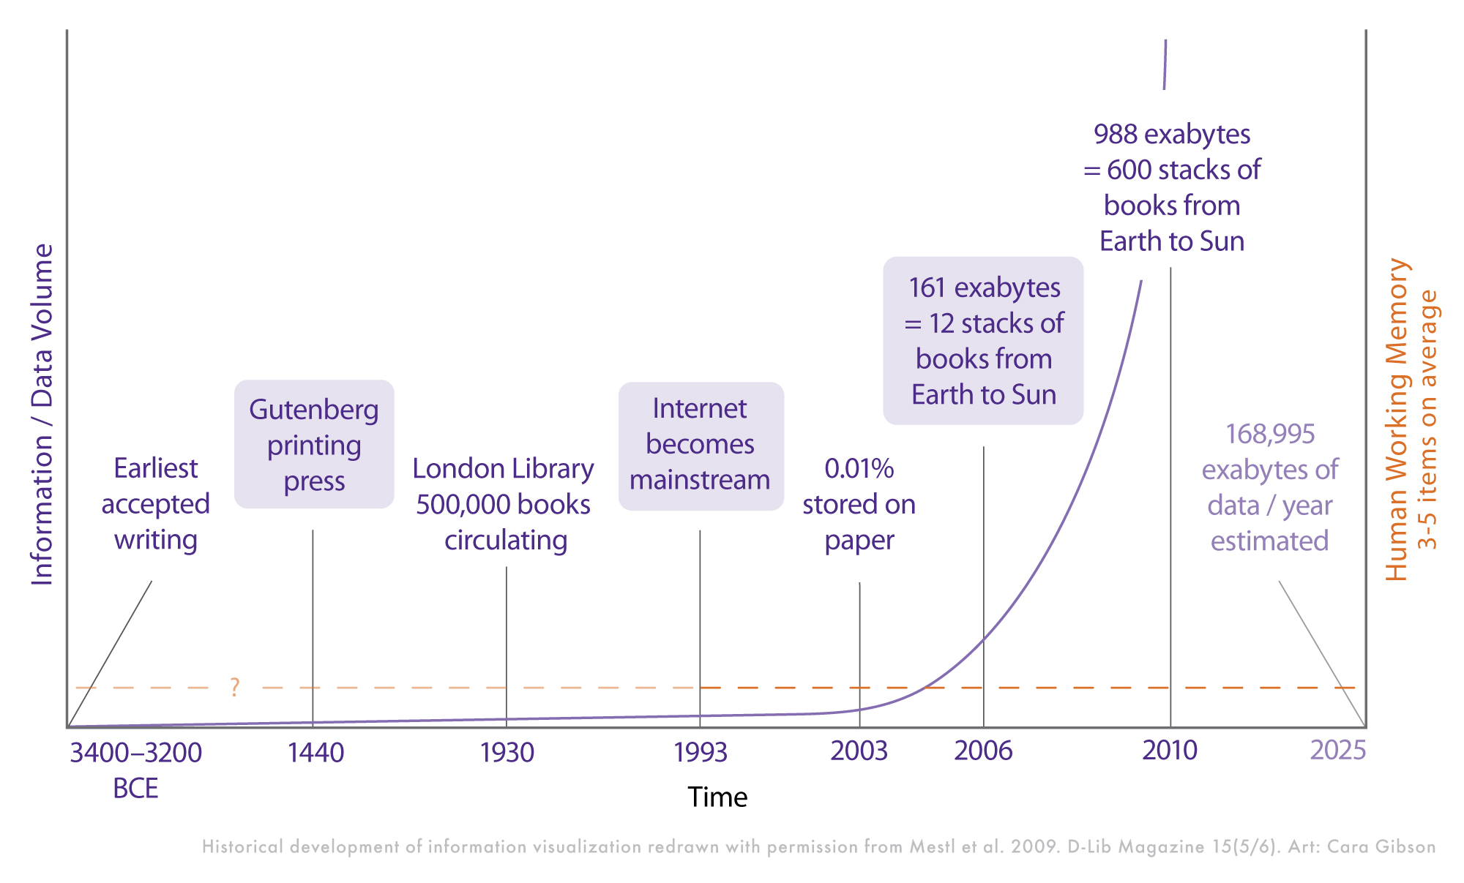
Information overload
Information overload is a state of being overwhelmed by the amount of data presented for one's attention or processing.

Slide 4
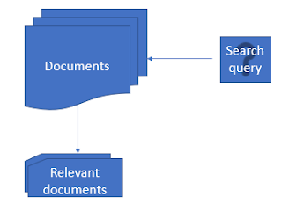
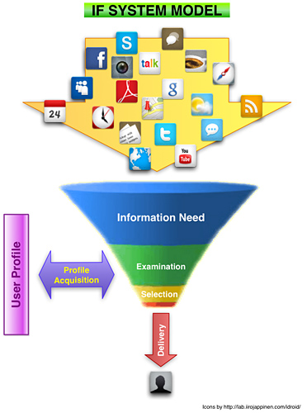
To overcome information overload -- information retrieval and information filtering
Information retrieval (e.g., search engines): obtaining information system resources that are relevant to an information need (usually for a query) from a collection of those resources.
Information filtering (e.g., recommender systems): the process of filtering information relevant to an individual’s information needs, in order to come to terms with the ever increasing amount of information.

Slide 5
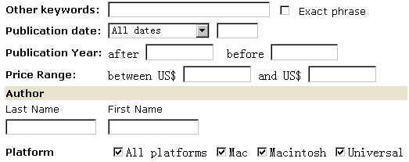


Information retrieval (IR)
It is ‘search’: mostly searching for documents, but can also be others.
It is a computer science discipline that designs and implements algorithms and tools to help people find information that they want.
From one or multiple large collections of materials (text or multimedia, structured or unstructured, with or without hyperlinks, with or without metadata, in a foreign language or not),
Where people can be a single user or a group.
Who initiate the search process by an information need, and, the resulting information should be relevant to the information need (based on the judgement by the person who starts the search).
Book search
Web search
Food search

Slide 6
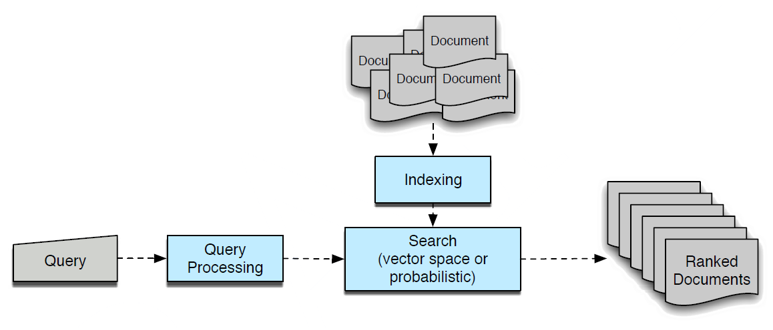
Process of information retrieval
Some of the key issues
Information need: query and query processing
Relevance: indexing documents and search algorithm
Evaluation: document ranking, precision-recall, etc.

Slide 7
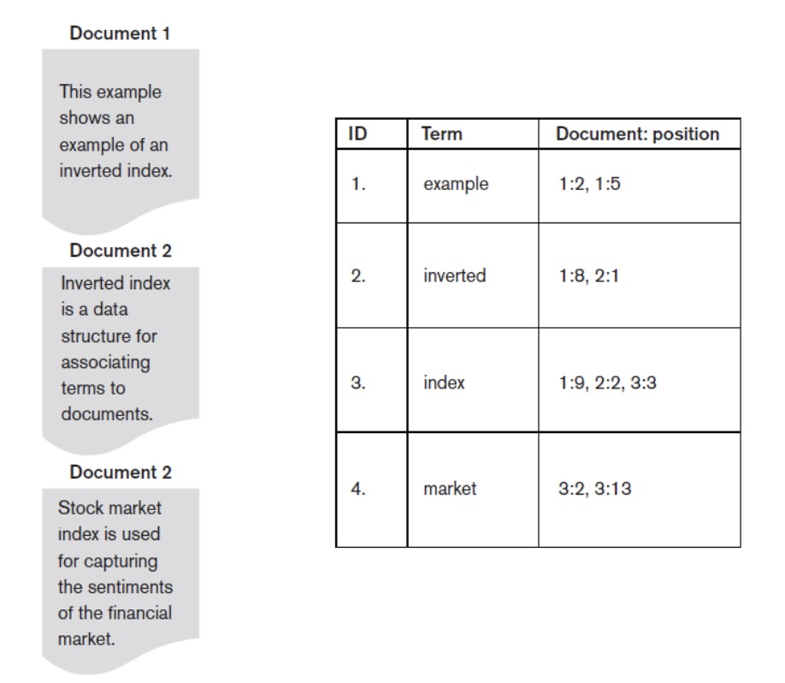
Indexing
Document indexing: tags documents with certain attributes or labels that can later be efficiently searched through and retrieved.
Build the vocabulary: set of distinct query terms in the document set.
Use inverted index: data structure that attaches distinct terms with a list of all documents that contains the term

Slide 8
How to find relevant documents for a query?
By keyword matching
Boolean model
By similarity
Vector space model
By imaging how to write out a query
How likely a query is written with this document in mind.
Generate with some randomness
Query generation language model
By trusting how other web pages think about the web page
Pagerank, hits
By trusting how other people find relevant documents for the same or similar query
Learning to rank

Slide 9
Vector space model (1)
Treat the query as a tiny document
Represent the query and every document each as a word vector in a word space
Rank documents according to their proximity to the query in the word space

Slide 10
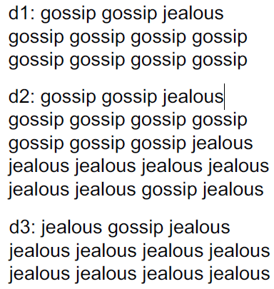
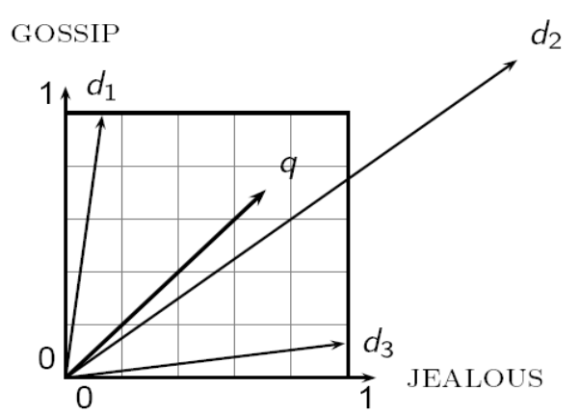
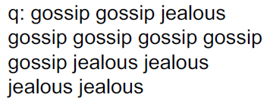
Vector space model (2)
Represent documents in a space of word vectors
Suppose the corpus only has two words: ‘Jealous’ and ‘Gossip’, they form a space of ‘Jealous’ and ‘Gossip’.

Slide 11
Vector space model (3)
Euclidean distance
If if p = (p1, p2,..., pn) and q = (q1, q2,..., qn) are two points in the Euclidean space, their Euclidean distance is
Here, if you look at the content (or we say the word distributions) of each document, d2 is actually the most similar document to q.
However, d2 produces a bigger Euclidean distance score to q.

Slide 12
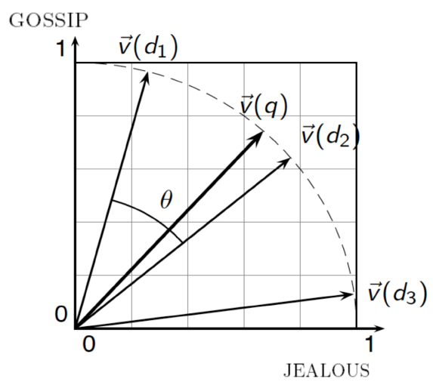
Vector space model (4)
Use angle instead of distance
Short query and long documents will always have big Euclidean distance
Key idea: rank documents according to their angles with query.
The angle between similar vectors is small, between dissimilar vectors is large.
This is equivalent to perform a document length normalization.

Slide 13
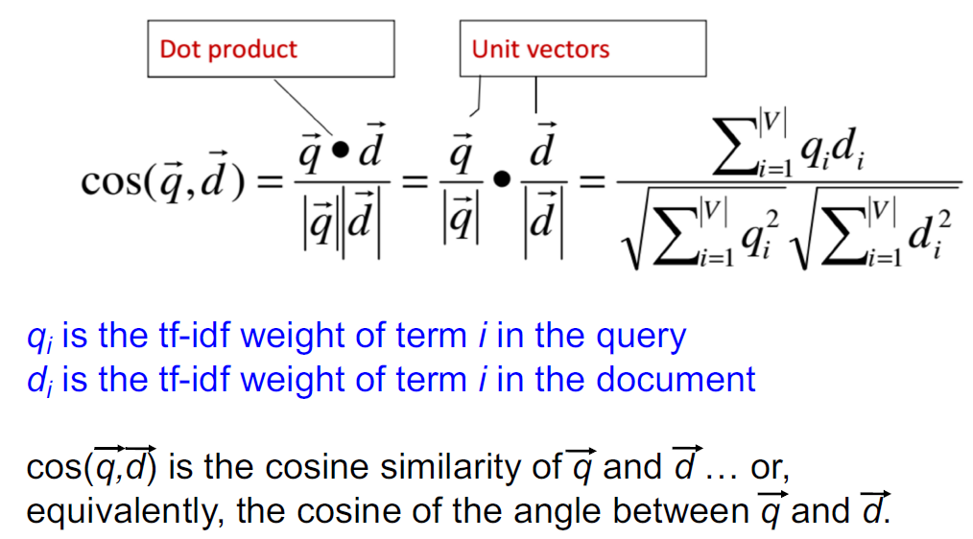
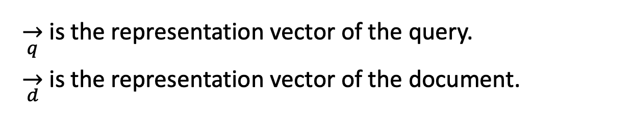
Vector space model (5)
Cosine Similarity
$\overset{→}{q}$ is the representation vector of the query.
$\overset{→}{d}$ is the representation vector of the document.

Slide 14
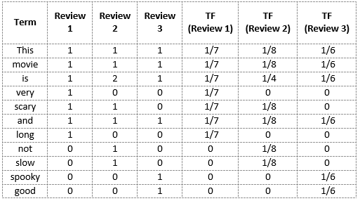
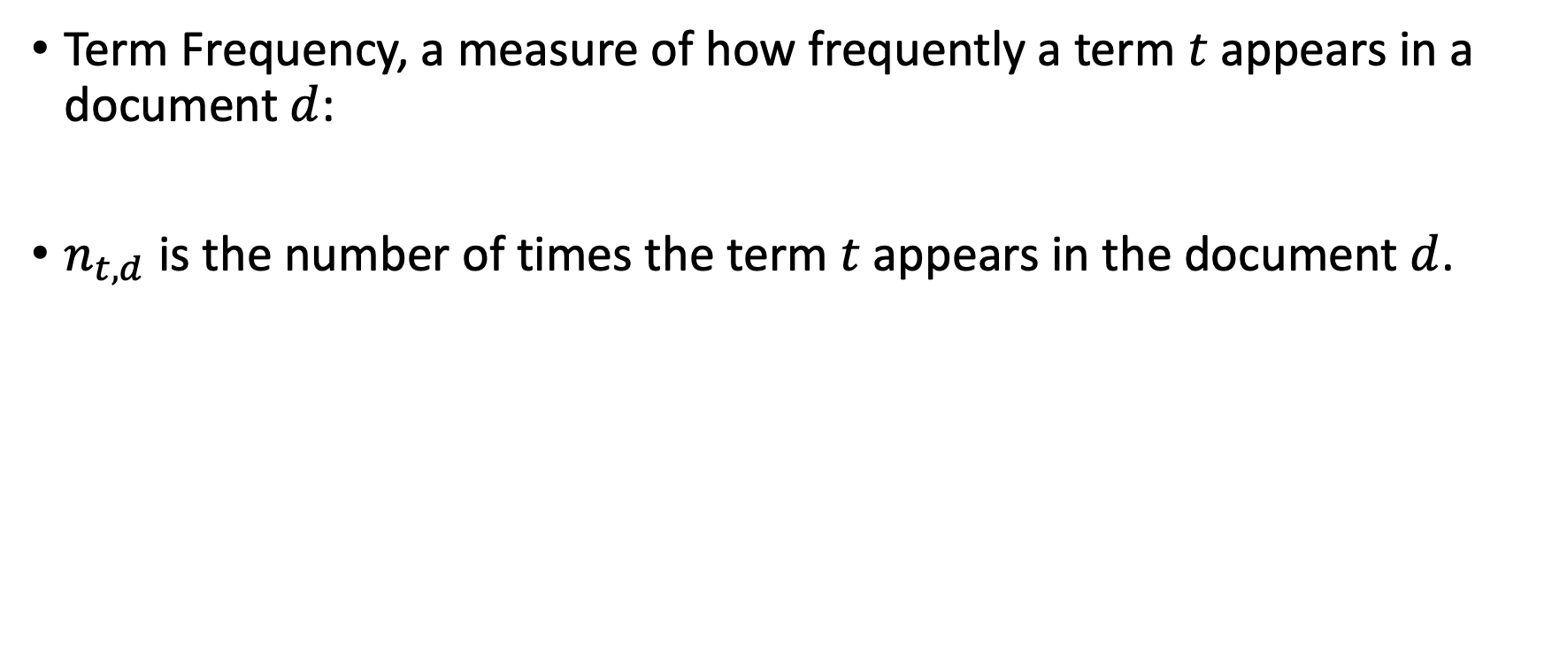
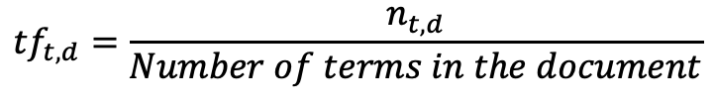
Vector space model – TF-IDF representations (1)
Term Frequency, a measure of how frequently a term $t$ appears in a document $d$:
$n_{t,d}$ is the number of times the term $t$ appears in the document $d$.
$${tf}_{t,d}=\frac{n_{t,d}}{Number of terms in the document}$$
Review 1: This movie is very scary and long
Review 2: This movie is not scary and is slow
Review 3: This movie is spooky and good

Slide 15
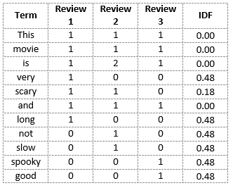
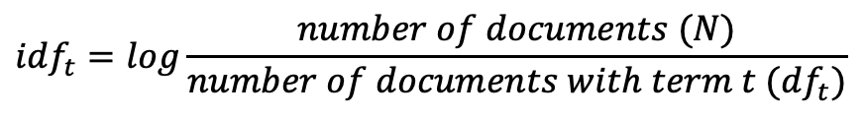
Vector space model – TF-IDF representations (2)
Inverse Document Frequency (IDF): a measure of how important a term is.
$${idf}_{t}=log\frac{number of documents (N)}{number of documents with term t ({df}_{t})}$$
Review 1: This movie is very scary and long
Review 2: This movie is not scary and is slow
Review 3: This movie is spooky and good
IDF(‘this’) = log(number of documents / number of documents containing the word ‘this’) = log(3/3) = log(1) = 0
Little importance: “is”, “this”, “and”
More importance: “scary”, “long”, “good”
Notes:
Inverse Document Frequency (IDF): a measure of how important a term is. We need the IDF value because computing just the TF alone is not sufficient to understand the importance of words:
Hence, we see that words like “is”, “this”, “and”, etc., are reduced to 0 and have little importance; while words like “scary”, “long”, “good”, etc. are words with more importance and thus have a higher value.

Slide 16
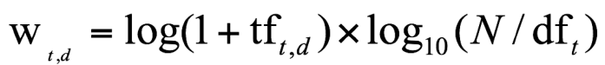
Vector space model – TF-IDF representations (3)
TF-IDF weighting
Product of a term’s tf weight and idf weight regarding a document
Best known term weighting scheme in IR
Increases with the number of occurrences within a document
Increases with the rarity of the term in the collection

Slide 17
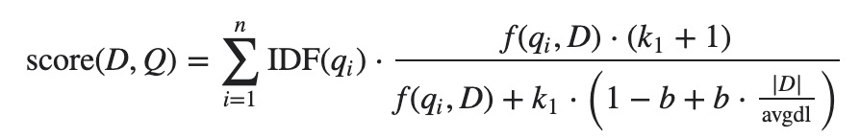
Ranking approaches – BM25
It is virtually a probabilistic ranking algorithm though it looks very ad-hoc.
For each document-query pair, compute the score functions and rank them
avgdl is the average document length in the text collection. k₁ and b are free parameters.

Slide 18
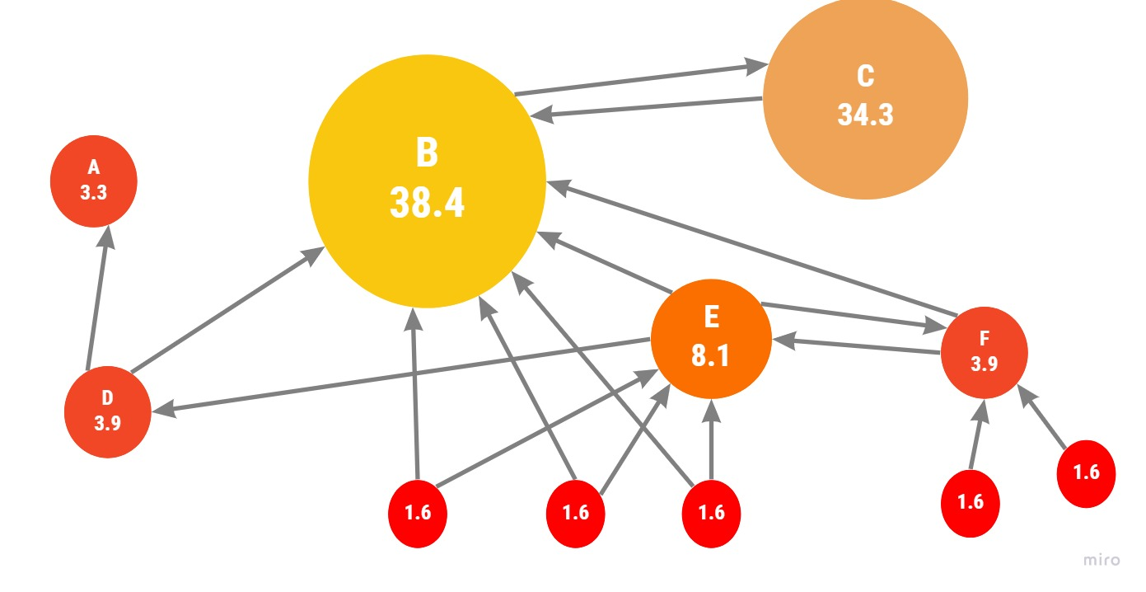
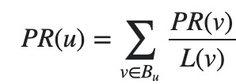
Ranking approaches – PageRank
Used by Google, to measure how important a webpage is.
Based on page linkage: highly linked pages are more important (have greater authority) than pages with fewer links.
Measure of query-independent importance of a page/node.
PageRank value for a page u is dependent on the PageRank values for each page v contained in the set B_{u} (the set containing all pages linking to page u), divided by the number L(v) of links from page v.

Slide 19
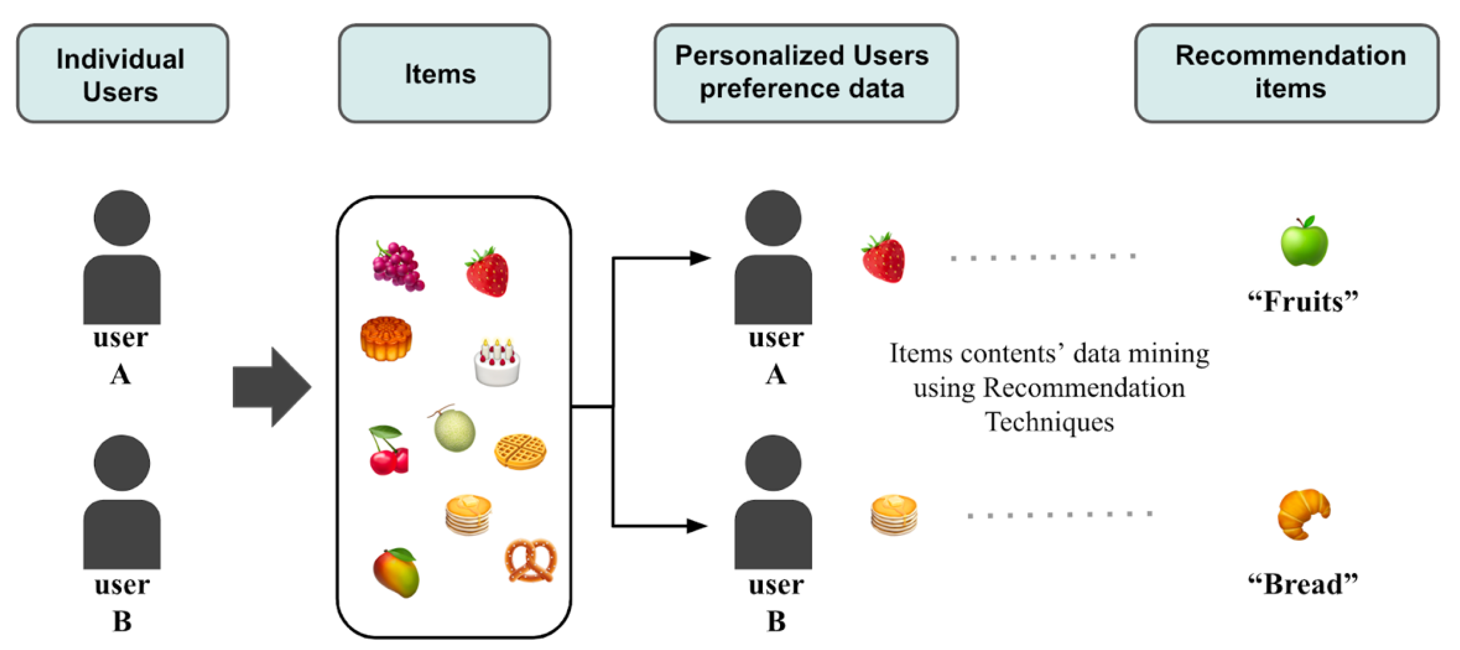
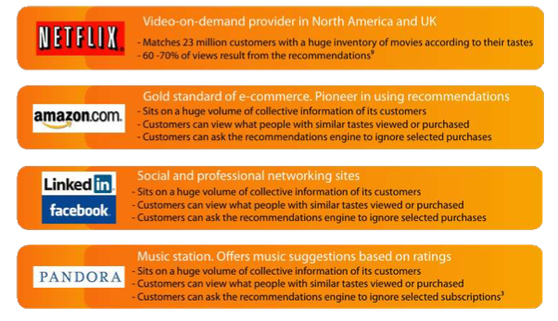
Recommender systems
Recommender systems: a subclass of information filtering system that provide suggestions for items that are most pertinent (of interest) to a particular user.

Slide 20
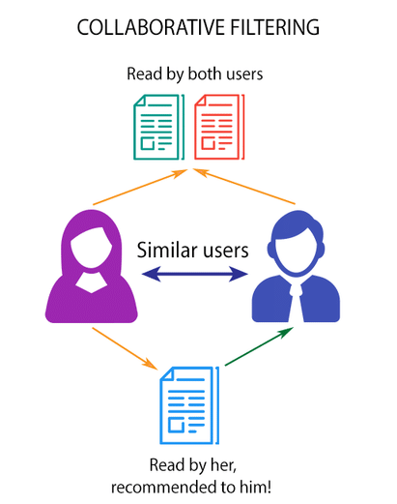
Recommendation approaches
Collaborative filtering method finds a subset of users who have similar tastes and preferences to the target user and use this subset for offering recommendations.
Basic Assumptions : - Users with similar interests have common preferences. - Sufficiently large number of user preferences are available.

Slide 21
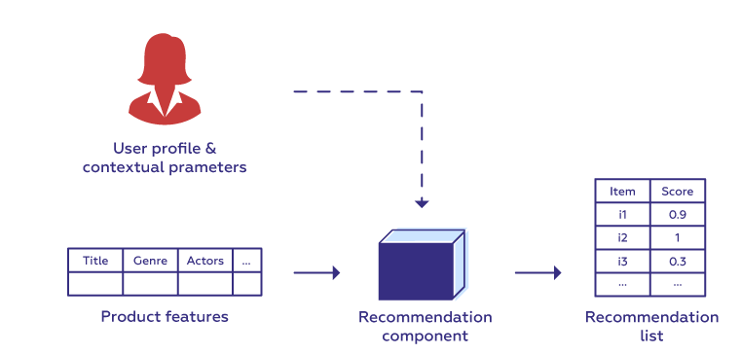
Collaborative filtering
collaborative filtering
neighborhood methods
latent factor models
Item/User based collaborative filtering: find similar items/users and recommend similar items.
Matrix factorization: represent each item and user as an embedding vector and calculate their preference score (e.g., inner product).
Item based collaborative filtering
User based collaborative filtering
Matrix factorization
A user/An item profile is a collection of settings and information associated with a user/an item.

Slide 22
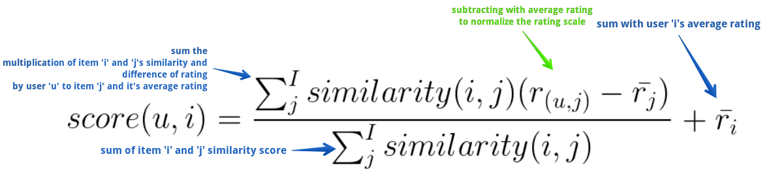
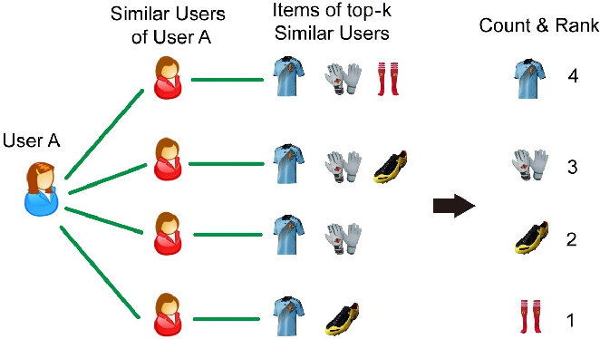
Collaborative filtering methods
1. Weight all users with respect to similarity with the active user.
2. Select a subset of the users (neighbors) to use as predictors.
3. Normalize ratings and compute a prediction from a weighted combination of the selected neighbors’ ratings.
4. Ranking: present items with highest predicted ratings as recommendations.
Make a recommendation based on user-item similarity score rankings

Slide 23
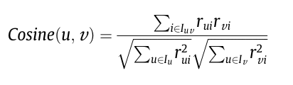
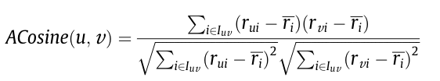
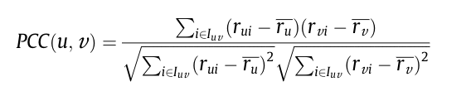
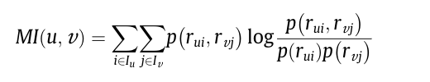
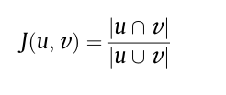
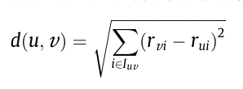
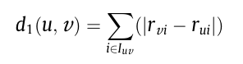
Item/User based collaborative filtering
Calculate user-user, item-item, user-item similarity scores
Vector similarity (Cosine)
Adjusted cosine vector
Pearson Correlation Coefficient (PCC)
Adjusted mutual information
Jaccard
Euclidean distance
Manhattan distance

Slide 24
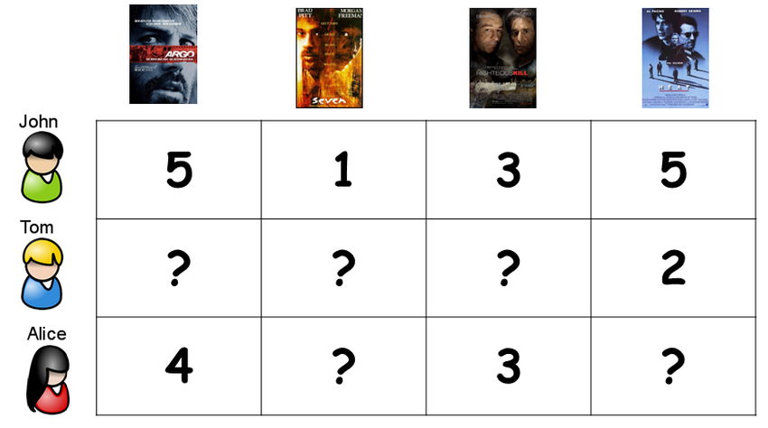



User-based collaborative filtering (1)
Use user-item rating matrix
Make user-to-user correlations
Find highly correlated users
Recommend items preferred by those users
Rating matrix
Item a
A
a
b
d
User A
Item b
User B
B
c
Item c
User C
C
a
b
Item d
Notes:
As I mentioned before, the core of the collaborative filtering algorithm is "finding similarities". It could be based on the user's historical behavior like browsing, favorites, comments, etc to find the user's preferences for items, and measure and score the preferences, and finally, filter out the recommended set.
For example, in the figure below, user A and user C have both purchased item a and item b, then A and C can be considered similar, because they like many items in common. In this way, the item d purchased by user A can be recommended to user C.

Slide 25
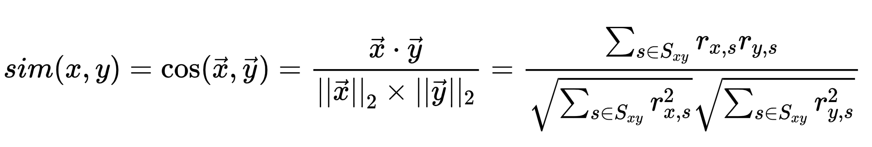
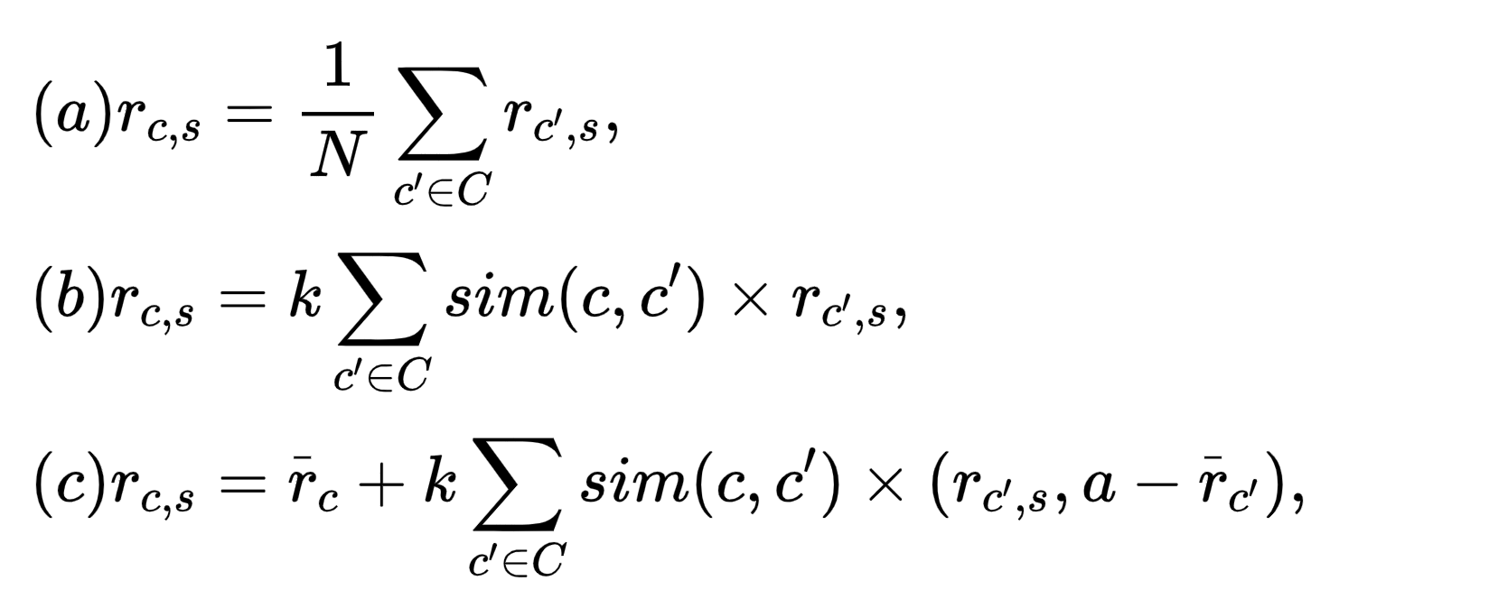
User-based collaborative filtering (2)
Use user-item rating matrix
Make user-to-user correlations
Find highly correlated users
Recommend items preferred by those users
Item a
A
a
b
d
User A
Item b
User B
B
c
Item c
User C
C
a
b
recommended
Item d
Notes:
As I mentioned before, the core of the collaborative filtering algorithm is "finding similarities". It could be based on the user's historical behavior like browsing, favorites, comments, etc to find the user's preferences for items, and measure and score the preferences, and finally, filter out the recommended set.

Slide 26

Item-based collaborative filtering (1)
Use user-item rating matrix
Make item-to-item correlations
Find highly correlated items
Recommend user with similar items
Rating matrix
User A
Item a
A
a
b
c
User B
Item b
B
a
b
User C
Item c
C
a
b
d
User D
Item d
D
a
Notes:
For example, in the figure below, our task is to recommend item b to appropriate user. item a and item b are purchased by users A, B, and C at the same time, then item a and item b are considered similar because they have a high number of co-occurrences.
In this way, if user D purchases item a, the item b that is most similar to item a
And thus item b can be recommended to user D.

Slide 27
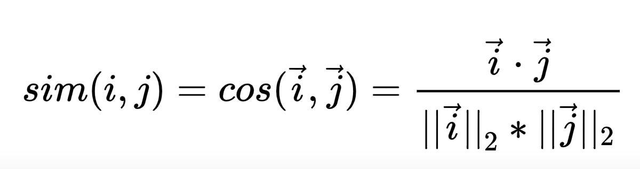
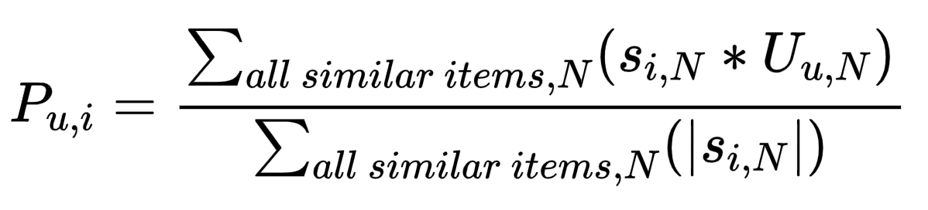
Item-based collaborative filtering (2)
Use user-item rating matrix
Make item-to-item correlations
Find highly correlated items
Recommend user with similar items
User A
Item a
A
a
b
c
User B
Item b
B
a
b
User C
Item c
C
a
b
d
recommended
User D
Item d
D
a
Notes:
For example, in the figure below, our task is to recommend item b to appropriate user. item a and item b are purchased by users A, B, and C at the same time, then item a and item b are considered similar because they have a high number of co-occurrences.
In this way, if user D purchases item a, the item b that is most similar to item a
And thus item b can be recommended to user D.

Slide 28
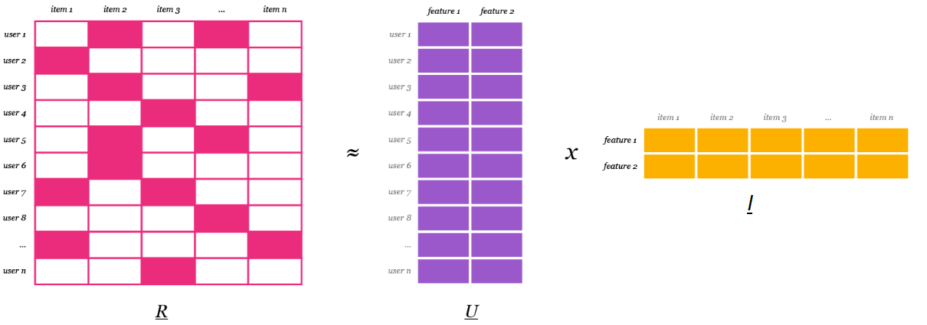
Matrix factorization – illustration
Using only user-item rating matrix (can only use profiles)
Factorize the matrix into a multiplication of two, each row/column will represent the user/item embeddings.
Ratings are approximated as the inner product of a user embedding and an item embedding.
Notes:
Rating prediction can only be applied to a small number of scenarios, such as ratings of movies and books. In fact, Top-N recommendations are more common with current needs and provide users with a list of recommendations for selection. Top-N recommendations are generally measured by accuracy rate and recall rate. Among them, let R(u) be the recommendation list made to the user based on the user's behavior on the training set (referring to the predicted recommendation list), and T(u) is the user's behavior list on the test set (referring to the real Ground Truth), these are two confusing concepts.

Slide 29
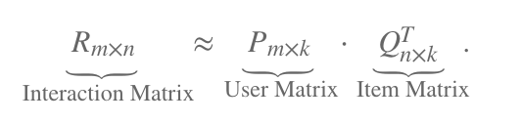

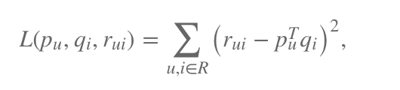
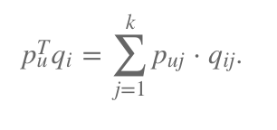
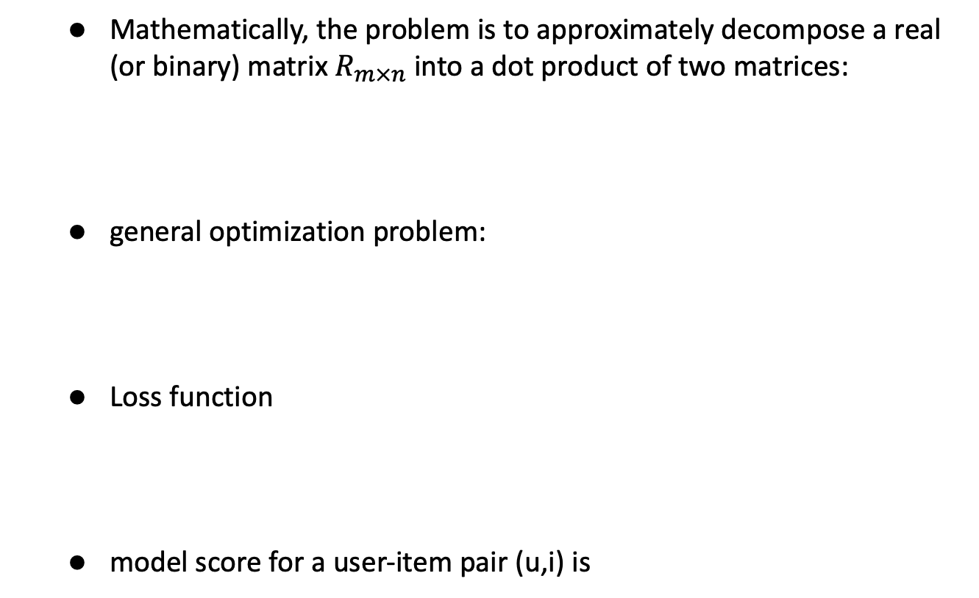
Matrix factorization
Mathematically, the problem is to approximately decompose a real (or binary) matrix $R_{m×n}$ into a dot product of two matrices:
general optimization problem:
Loss function
model score for a user-item pair (u,i) is
Koren, Yehuda, Robert Bell, and Chris Volinsky. "Matrix factorization techniques for recommender systems." Computer 42.8 (2009): 30-37.
Notes:
Rating prediction can only be applied to a small number of scenarios, such as ratings of movies and books. In fact, Top-N recommendations are more common with current needs and provide users with a list of recommendations for selection. Top-N recommendations are generally measured by accuracy rate and recall rate. Among them, let R(u) be the recommendation list made to the user based on the user's behavior on the training set (referring to the predicted recommendation list), and T(u) is the user's behavior list on the test set (referring to the real Ground Truth), these are two confusing concepts.

Slide 30
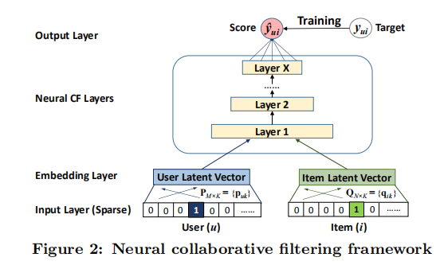
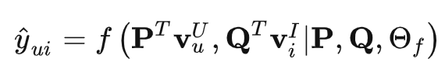
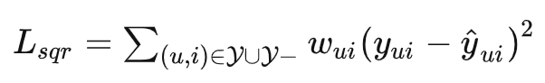
Neural collaborative filtering
Input layer: using the identity of a user and an item as the input feature, transforming it to a binarized sparse vector with one-hot encoding.
Embedding Layer: This layer turns the sparse vector into dense.
Neural CF Layers: Multiple hidden layers to achieve nonlinear transformation
Output Layer : Finally output a score that minimizes the pointwise between predicted and true values
He, Xiangnan, et al. "Neural collaborative filtering." Proceedings of the 26th international conference on world wide web. 2017.
Notes:
Rating prediction can only be applied to a small number of scenarios, such as ratings of movies and books. In fact, Top-N recommendations are more common with current needs and provide users with a list of recommendations for selection. Top-N recommendations are generally measured by accuracy rate and recall rate. Among them, let R(u) be the recommendation list made to the user based on the user's behavior on the training set (referring to the predicted recommendation list), and T(u) is the user's behavior list on the test set (referring to the real Ground Truth), these are two confusing concepts.

Slide 31
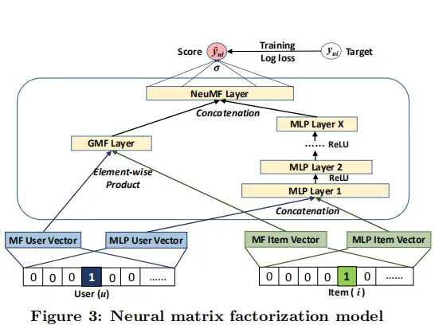


Neural matrix factorization
Fusion of GMF and MLP
Latent vectors for MF and for CF.
Concatenation to calculate final scores
He, Xiangnan, et al. "Neural collaborative filtering." Proceedings of the 26th international conference on world wide web. 2017.
Notes:
Rating prediction can only be applied to a small number of scenarios, such as ratings of movies and books. In fact, Top-N recommendations are more common with current needs and provide users with a list of recommendations for selection. Top-N recommendations are generally measured by accuracy rate and recall rate. Among them, let R(u) be the recommendation list made to the user based on the user's behavior on the training set (referring to the predicted recommendation list), and T(u) is the user's behavior list on the test set (referring to the real Ground Truth), these are two confusing concepts.
The meaning of accuracy is how much of the predicted recommendation list is really of interest to users, that is, the accuracy of the predicted list, then the accuracy is defined as:
The significance of the recall rate is how much of the list that the real user is interested in is accurately predicted by the recommendation algorithm, that is, the recall rate of the real list, then the recall rate is defined as:
The two evaluation indicators measure the quality of the recommender system from different aspects, and the two show a negative correlation, that is, the recall rate tends to be lower when the accuracy rate is high, and vice versa. Therefore, people have proposed an evaluation index F1 value that combines the accuracy rate and the recall rate, which can more conveniently observe the quality of the recommender system. The formula is as follows:

Slide 32

Recommendation evaluation
Rating prediction task
$Root−mean−square error RMSE=\frac{\sqrt{\sum_{u,i∈T}{{(r_{ui}−{\hat{r}}_{ui})}^{2}}}}{|T|}$
$Mean absolute error MAE=\frac{\sum_{u,i∈T}{|r_{ui}−{\hat{r}}_{ui}|}}{|T|}$
Top-N recommendation task
Hit rate
$Precision= \frac{\sum_{u∈U}{|R\left(u\right)∩T\left(u\right)|}}{\sum_{u∈U}{|R\left(u\right)|}}$, $Recall= \frac{\sum_{u∈U}{|R\left(u\right)∩T\left(u\right)|}}{\sum_{u∈U}{|T\left(u\right)|}}$, $F_{1}= \frac{2PR}{P+R}$

Slide 33
Recommendation challenges
Cold start & data sparsity
Filter bubble
Personalization

Slide 34
Thanks for your attention!

Slide 35
Appendix 1. Introduction to Information Retrieval. C.D. Manning, P. Raghavan, H. Schütze. Cambridge UP, 2008. 2. Search Engines: Information Retrieval in Practice. W. Bruce Croft, Donald Metzler, and Trevor Strohman. 2009.

